Slide 1

SciX Online Summer Programs
Grades 9-12: Text Based Adventure Game

Slide 2
Would You Rather?

Slide 3
Input and If Statements
We want software to be dynamic
respond to user input and behave differently with different user actions
Python: uses a combination of input and if statements
Input: this command lets the user enter text and allows us to store a variable

Slide 4

For example....
Notes:
When we run this code, the user can type in anything, and python will display it. This means that our code will work for any person ever!

Slide 5
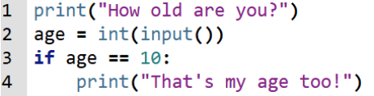
If Statements
If statements test if a statement is True or False
will run a chunk of code only if the statement is true. Consider the code:
One equal sign vs. Two equal signs
Notes:
Here, we’re testing the statement age == 10. If that is a true statement, python will run the indented line and if it’s false, python won’t run the line
Notice that when we set a variable, we use one equals sign. But when we test if two things are the same, we use two equals signs. This is done to avoid ambiguity in the language. Also, since input always gives us back a string, we have to turn it into an integer.

Slide 6
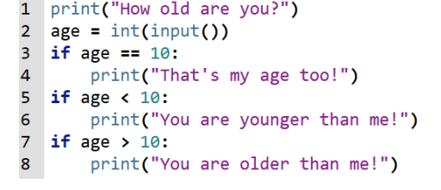
We can also have multiple if statements after each other!

Slide 7
Functions
chunks of code that can be called, and return some value
Procedural functions
We don't care about the return or they don't have a return
Useful to reuse code or make it easy to read
Notes:
For example, input is a function that runs a chunk of code that gets a string from the user, and then returns that string.
Procedural functions are functions where we don’t care about the return, or they don’t have a return. We use them just as a way to execute a bunch of code. This can be really useful if you want to reuse code, or make your code easier to read. It lets us physically move where the code is written in our source file.

Slide 8
We will be making a long adventure game where each choice presents the user with another choice!

Slide 9
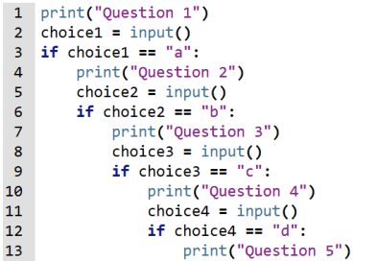
Without functions, we would need to have if’s inside of if’s like this:

Slide 10
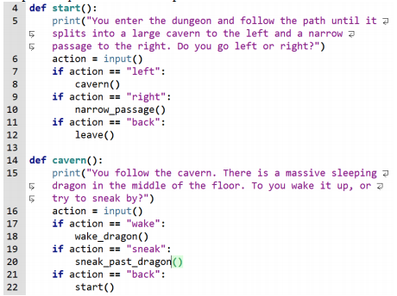
Procedure
use procedural functions to make a text based adventure game
Notes:
Students should allow the user to type “back” to go back to the previous function.

Slide 11

Procedure
We want to add some global memory to the game, meaning that we want it to be accessible in any function
We must declare global variables at the top of the file:

Slide 12
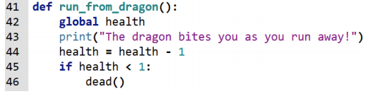
And then use the global keyword at the top of any function where we want to use it:

